Slide 1






Environmeow
FC conmeo

Slide 2
Environmeow
FC conmeo
Nguyen Phuc Bao Uyen
Trinh Tran Tran
Pham Gia Thinh
Nguyen Xuan Tung
Diep Tuong Nghiem

Slide 3


Table of content
Overview
About App
Conclusion
A brief introduction on our idea
What out app will have
Summarization of the idea

Slide 4


Overview
Only 54,5% people in Vietnam use clean water
According
to
Unicef

Slide 5





Overview
Countryside
43,6%
Mountainous
region
35,9%
City
74,7%
South East
70,3%

Slide 6



Overview
Mekong Delta Region
49,1%
Red River Delta Region
35,4%
41,4% Vietnamese use
water poisioned with E.coli

Slide 7

Overview
Vietnam ranks 20 in the top of countries in risk of Climate Change

Slide 8
What will Environmeow help to fix

Slide 9

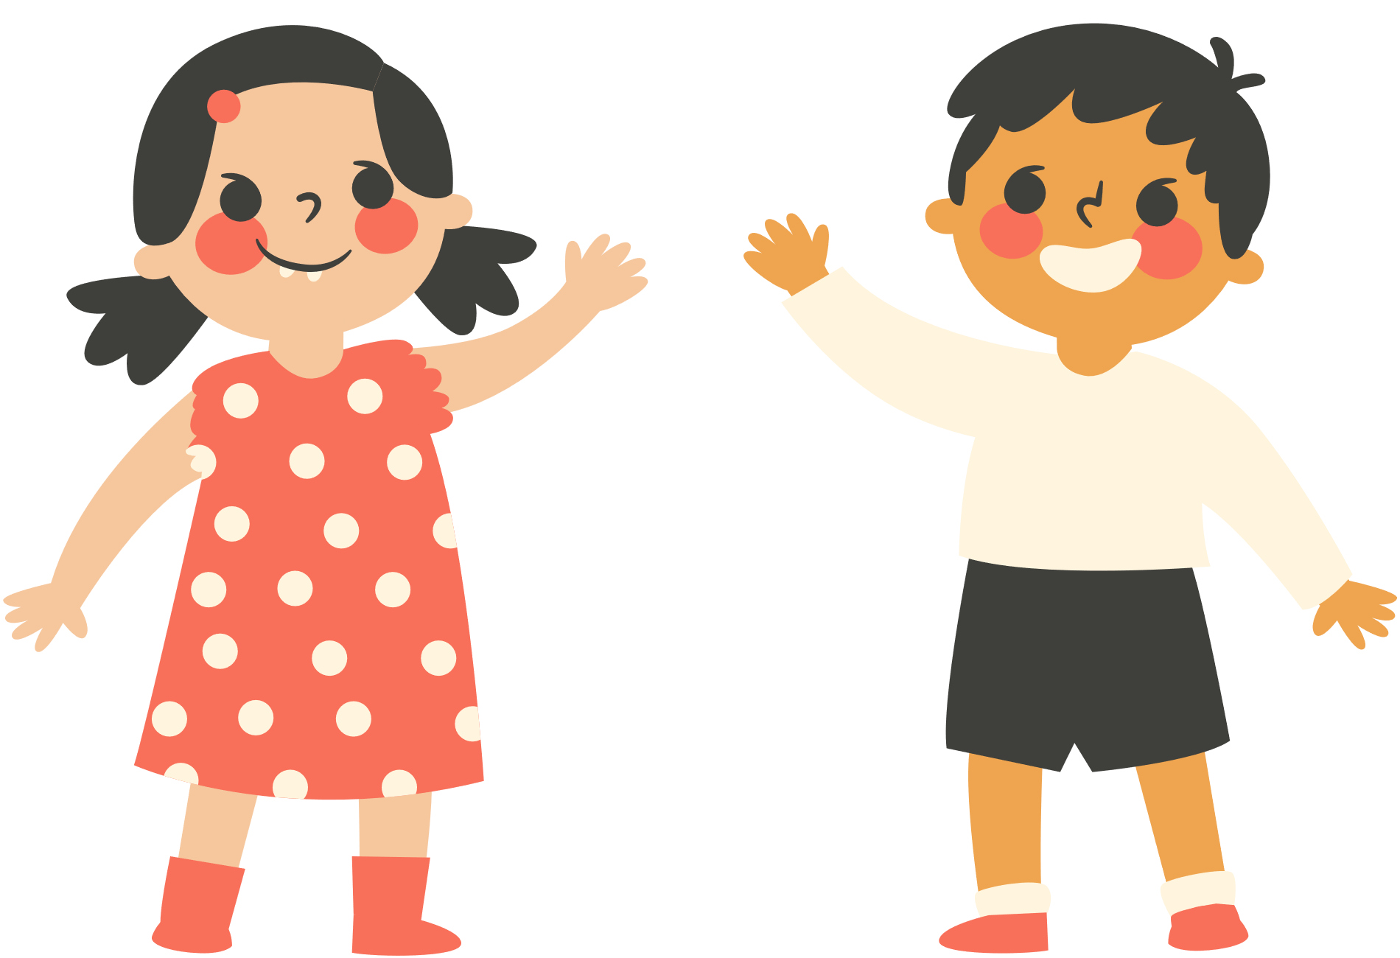

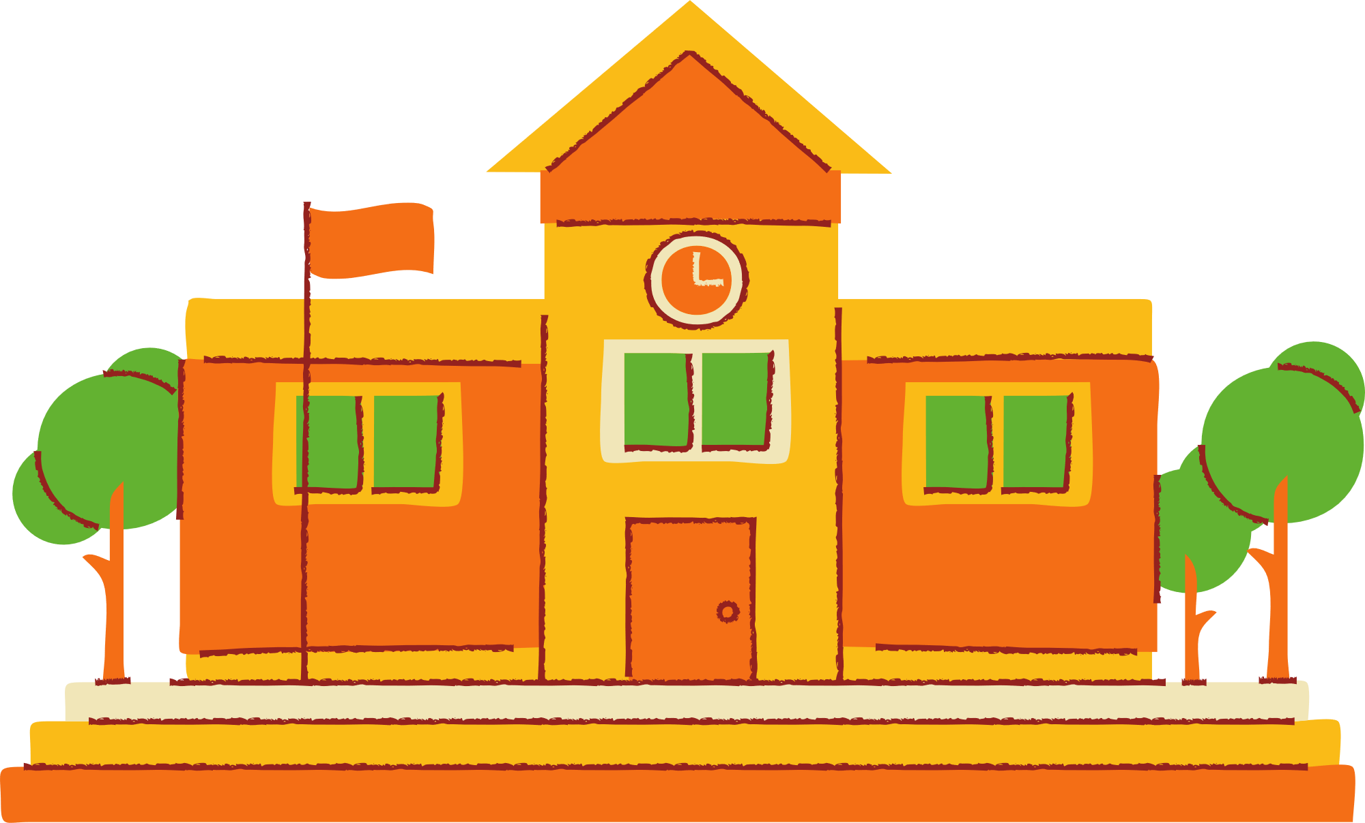
What will we help?
Educate young children
Raise awerness
Help school to educate

Slide 10
Product wire frame
Lesson 1
Lesson
Home
Lesson 2
News
Small facts

Slide 11
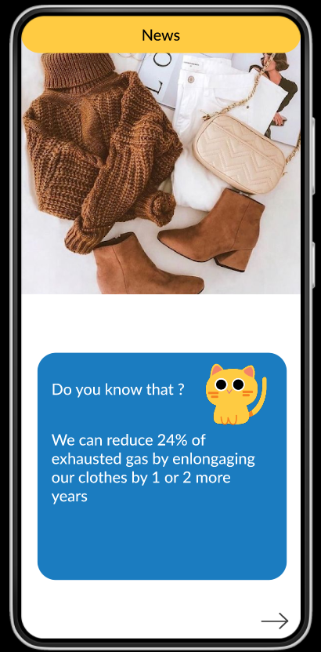
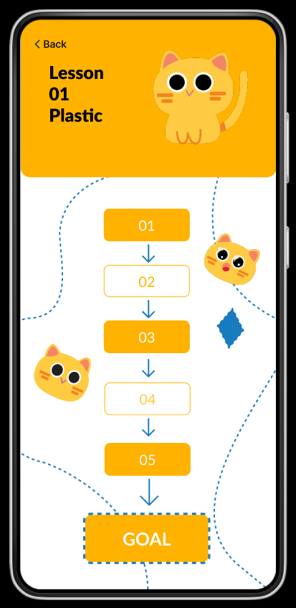
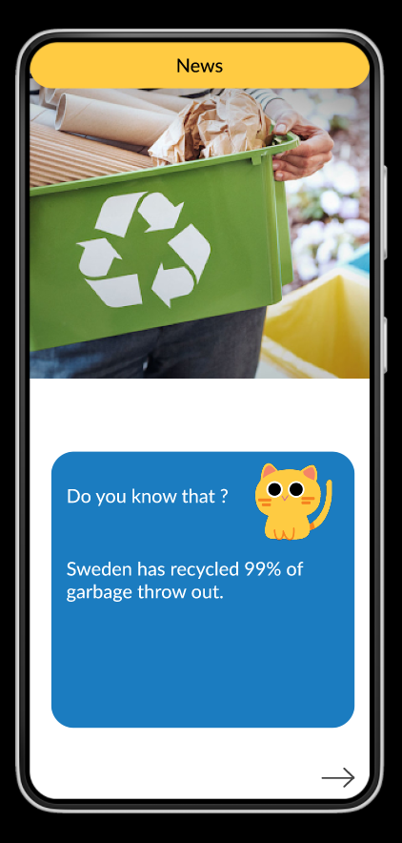
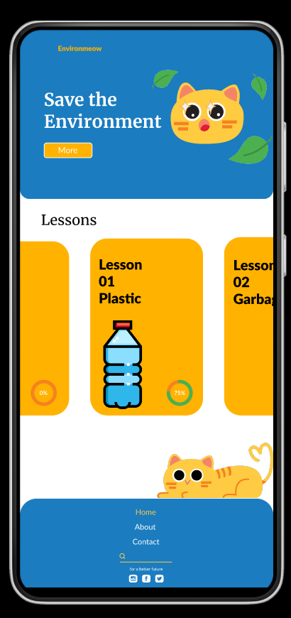
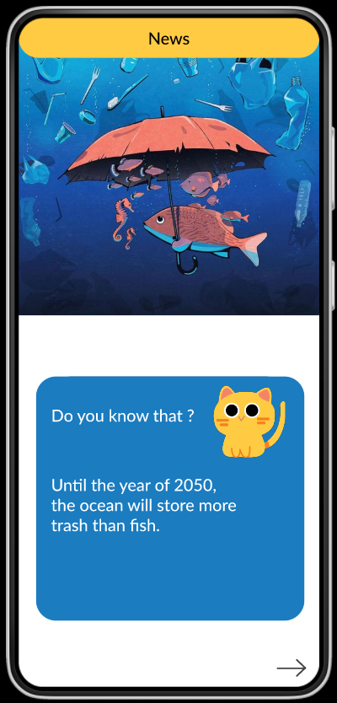
Product Demo

Slide 12
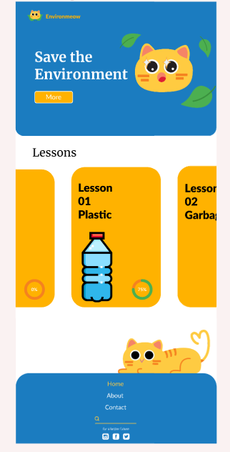
Homepage

Slide 13

Fact section
Lession section
Footer

Slide 14
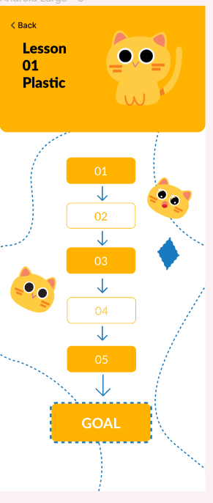

Lession
section

Slide 15
Lession will be
seperated into rounds

Slide 16
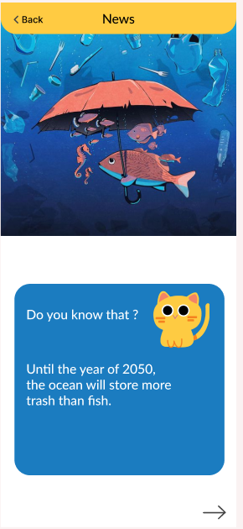
Facts section

Slide 17
Some random small
facts about
environment protection

Slide 18

We are trying to implement AI for sorting the garbage into different categories
Special

Slide 19
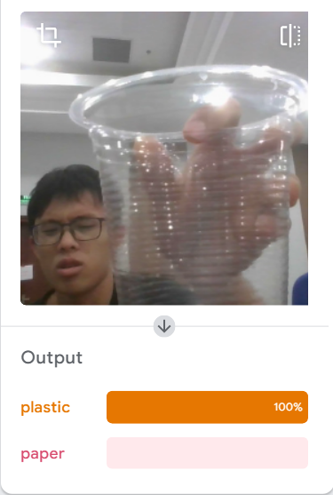
We are using an Ai training tool called “Teachable Machines” to classify which piece of trash is plastic or paper.

Slide 20
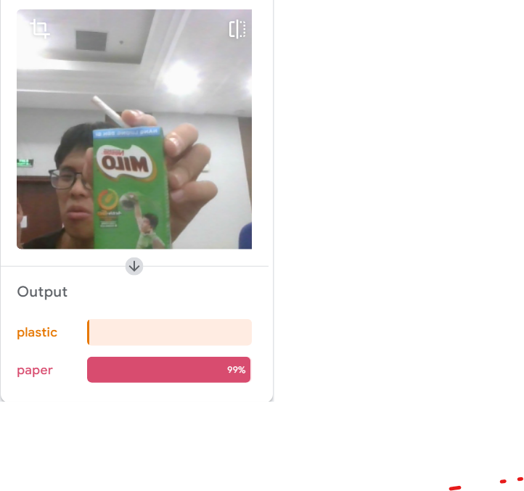
We are using an Ai training tool called “Teachable Machines” to classify which piece of trash is plastic or paper.

Slide 21

Conclusion
01
02
Raise awareness of people about environmental protection
User-friendly, easy to use
03
04
Help people to classify garbage
Multi-functions app

Slide 22
Thank you for listening! Meow meow

